Slide 1
Html5 canvas
An introduction into the canvas element - and wheel building.
Eric Menze
June 7, 2012

Slide 2
What is a canvas element?
Introduced by Apple in 2004 for WebKit
Now supported by all non-terrible browsers (so not IE7 or IE8)
Allows drawing via javascript and other libraries
Does not remember what was drawn on it – think Paint not Photoshop
Has anyone else used them?

Slide 3


Example

Slide 4

Result
Now to wheelbuilding….

Slide 5
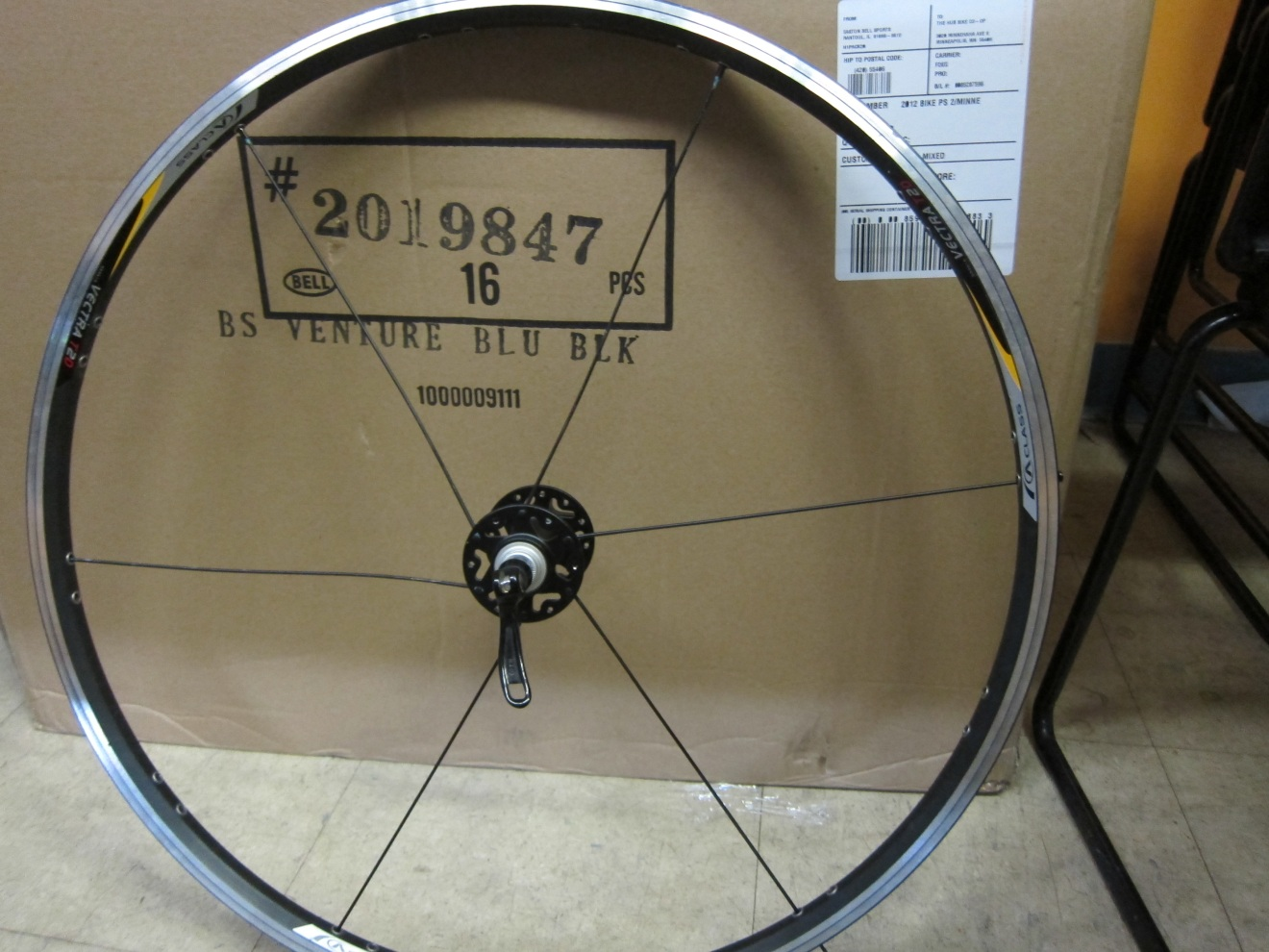
Wheelbuilding 1

Slide 6
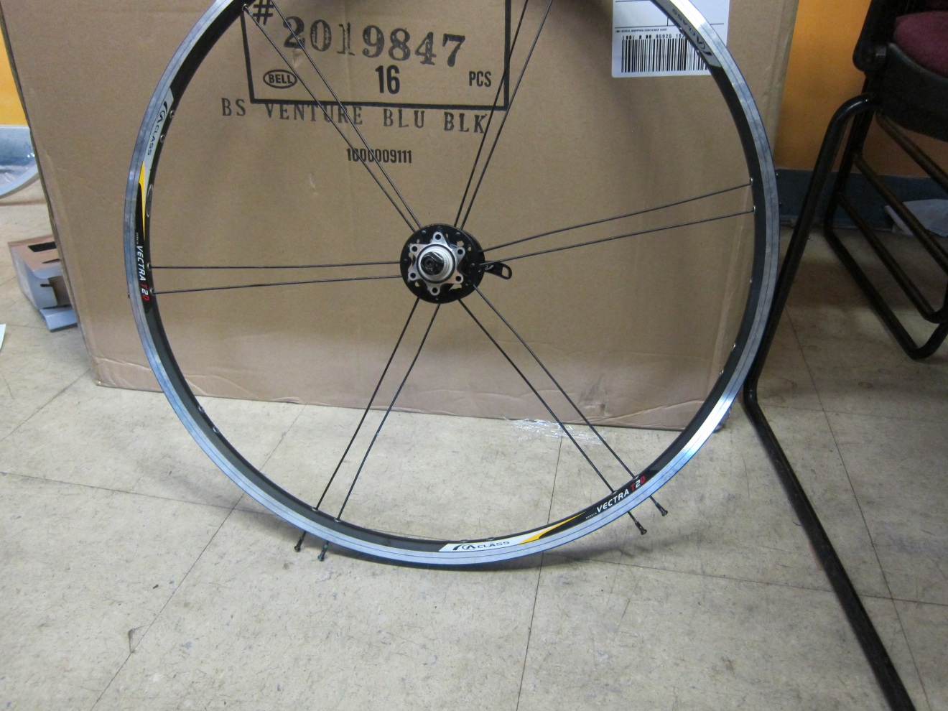
Wheelbuilding 2

Slide 7
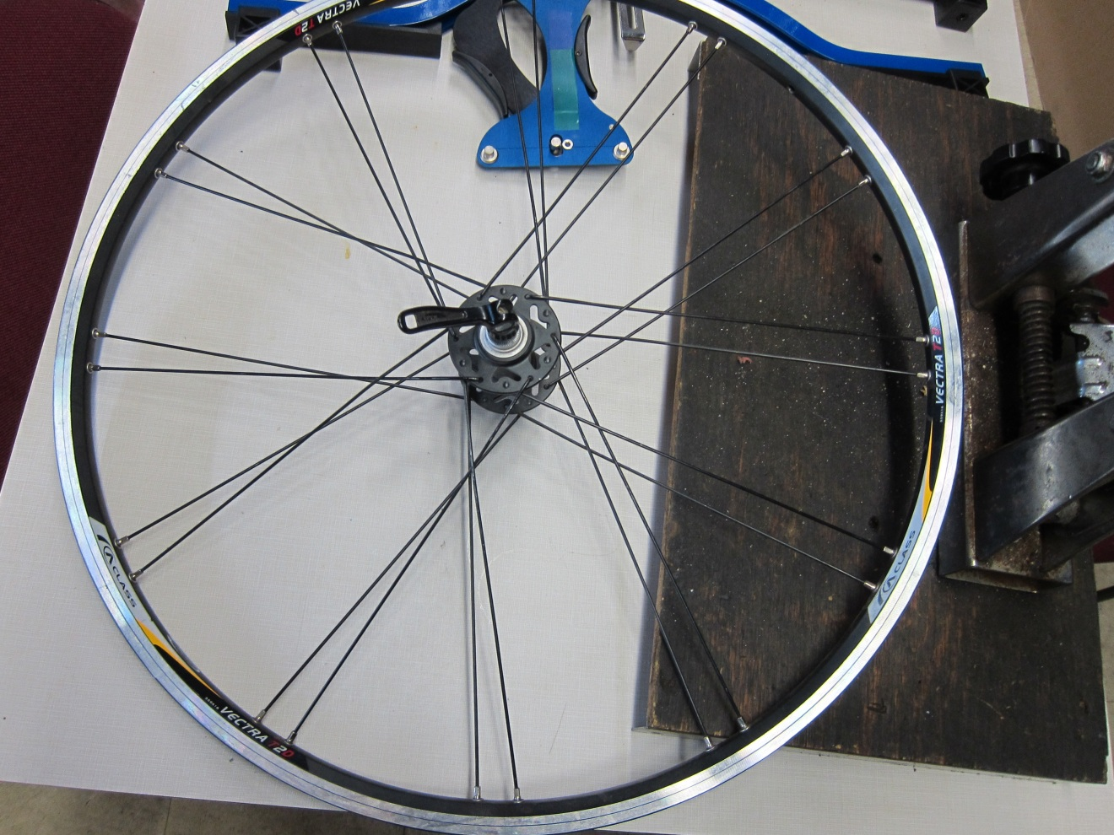
Wheelbuilding 3

Slide 8
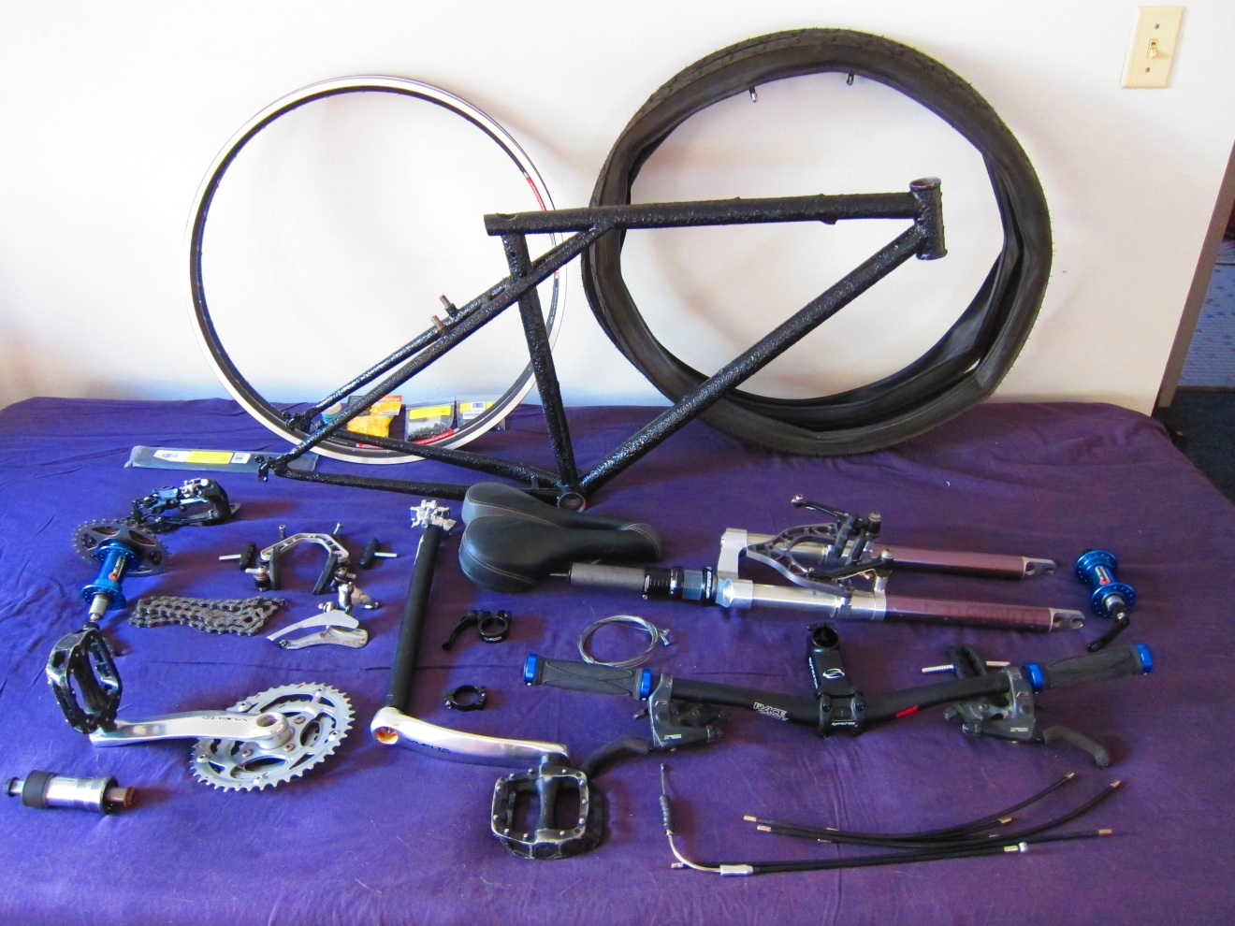
Start of project….

Slide 9
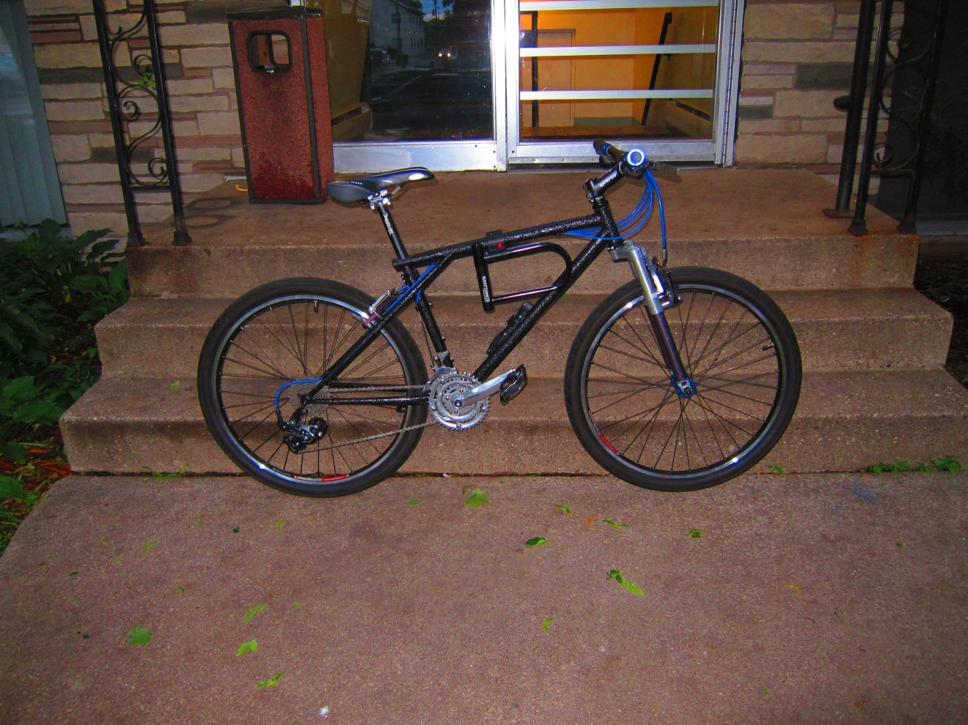
Finished!

Slide 10
How to calculate spoke lengths?
The best option: spocalc.xls (still pretty terrible)
Lack of visualization and variables
So: I use canvases in www.wheelspoking.com to do a better job!

Slide 11
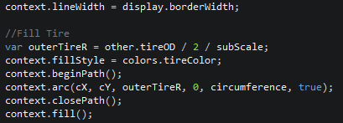
Drawing the Tire

Slide 12
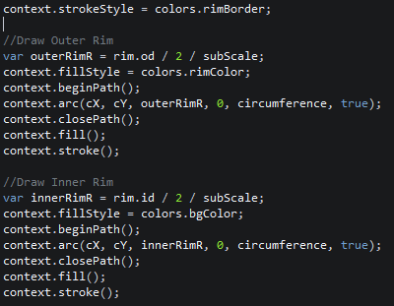
Drawing the Rim

Slide 13
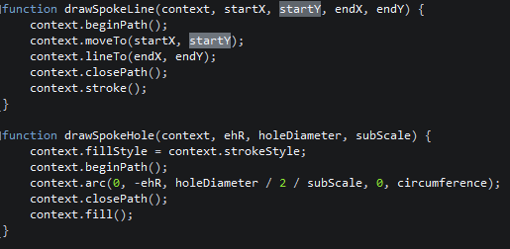
Drawing Spokes

Slide 14
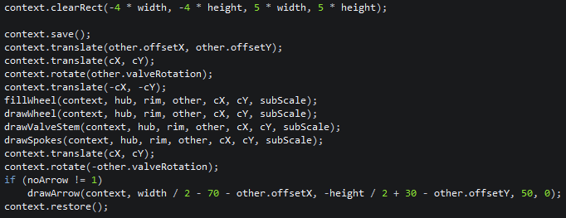
Translation
Translation: Move the coordinate system by a specified x and y value
I frequently translated the coordinate system to wheel center:

Slide 15
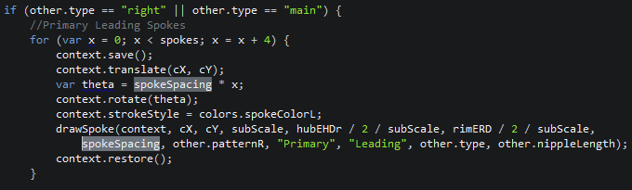
Rotation
Rotates the coordinate system
Instead of complicating the spoke process by converting to x/y coordinates, I rotated the canvas and reused the same values:

Slide 16
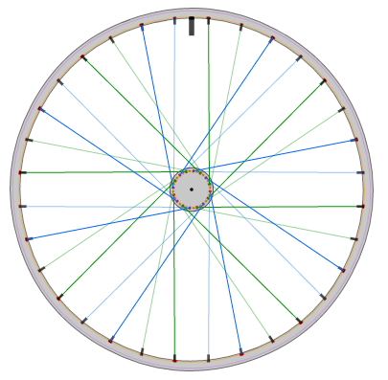
Drawn Wheel

Slide 17
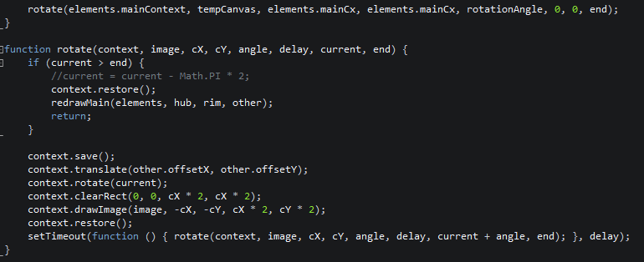
Animation
Animation can be accomplished by repeatedly redrawing the image with rotations, or saving the image and recopying repeatedly with rotation

Slide 18
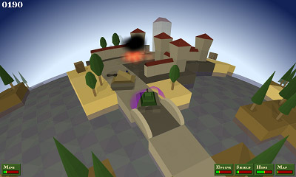

Other Usages? Canvas experience?
Some browsers support a ‘3D’ drawing mode: has anyone used this?
Multilayer canvas?

Slide 19
Questions? Comments? Concerns?

